Slide 1

LEGACIES GROUP CASE STUDY

Slide 2
Presentation Outline
Introduction
Case Problem
Data Set
Actions Taken
Findings
Recommendations

Slide 3
LEGACIES GROUP Also known as Legacies Media and Entertainment, Legacy Group was formed in 2010, owned by the largest commercial radio company in America. The group owns and operates seven core radio brands, all using a national network strategy. They are also owners and operates one of the leading out of home advertising (OOH) companies in America.
Case Problem
Legacies is experiencing a significant number of employee absenteeism, which is negatively impacting productivity, team performance, disrupts workflow and increase the work loads for other employees in the end the overall morale and engagement of the workforce is also affected.
Data Set
The Ms Excel dataset given to us by Legacy Group, contained 21 columns. The features included employee name, marital status of the employees, employee’s unique ID, their sex which was either male or female. The date of hire and date of termination, term reason, employment , department, manager’s name, manager id , recruitment source , performance, engagement survey, employee satisfaction, last performance review and abscences.

Slide 4
As a team , we took the following actions The data presented was very complex and to make it easy to analyse I had to study for a while. In the end , these were the actions that we took; -I added a column for active years which we arrived at with the formula INT( LAST PERFORMANCE REVIEW DATE - DATE OF STARTING)/365. -I used tableau to create the following visuals to analyse our data. 1. I visualized Employee Engagement by Gender 2. Recruitment Source by Employee Engagement which we filtered with performance score (all, exceeds, fully meets, needs improvement and PIP) 3. Absenteeism by Department which was filtered by Employment Status ( All, Active, Terminated for cause, voluntarily terminated). 4. Workers Descent by Employee Engagement. 5. Marital Status by Engagement and Absenteeism.

Slide 5
7. Number of Employee by Age Group, filtered by Performance Score and Employment Status. 8. Abscenteeism by Term Reason.\ 9.Abscenteeism by Engagement and Race, filtered by Employment Status. 10. Employee Satisfaction rate, filtered by Performance Score. 11. I created two dashboards in tableau to visualize all the analysis made.
As a team we identified the following.Contd

Slide 6
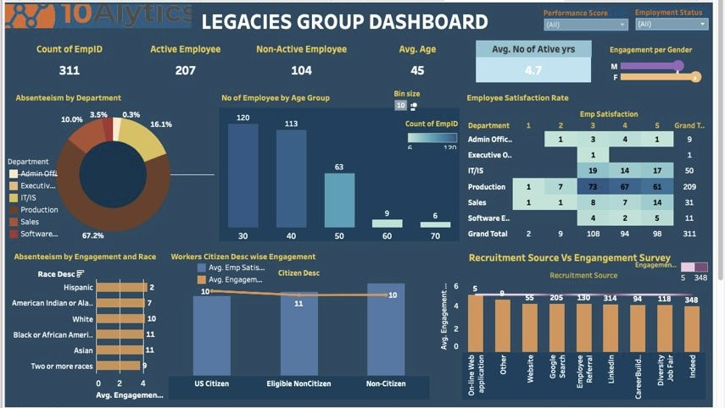

Slide 7
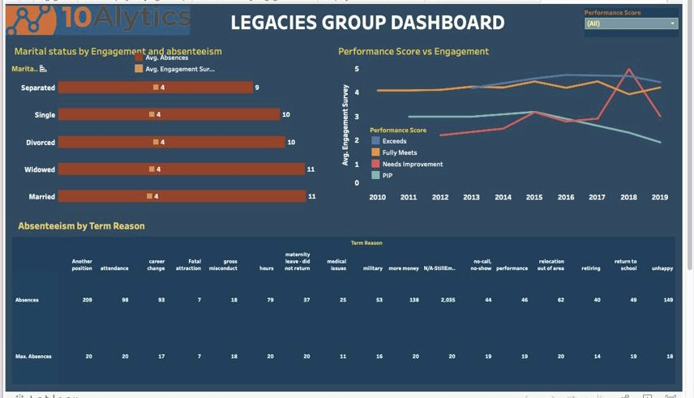

Slide 8
Findings
Legacies group company has recruited a total number of 311 employees ever since the company was formed, out of which 176 are Female 135 are Male. The current number of Active Employees are 207.
The highest number of Absence days by Employee are 20 irrespective of the active number of years of the worker.
The company recruited highest number of their Employees from Indeed (89) while the lowest number of Employees are from Online (1) followed by Others (2), yet recruitment sources have no significant impact on the input of employees, as the highest score for engagement survey is 5 ( Engagement survey from all the sources. )In terms of Absenteeism, Website has minimum percent of 90 while the highest is 111 percent from Diversity Job Fair. Google search has 162% and 147% being the performance score of those that Exceed or Need improvement respectively.
Gender status of employee did not affect their inputs (known as Engagement Survey) having the average 4 per gender, Average no of absence is 10 days.

Slide 9
Findings
The company has six Departments of which Production has the highest numbers of Employee (209) and Total percentage of Absence days (66.6%) The executive office has the lowest number of Employee (1). Productions tends to have the highest number of employees in all ranks of performance score and employment status. Satisfaction rate 3 has the highest rating in all the departments.
Marital status has no effect on the Input of the Employee, but then the Married and Widow tend to have the highest Avg. number of absences days, especially the Married with highest Avg. number of absence days for those that need improvement in their performance score.
Age band 30 to 39 has the highest number of employees recruited. The Performance score age band 40 to 49 has highest number of employees who have exceeded in performance score. In summary age band 30 to 39 represent highest number of persons with best to worst performance score and highest number of Active and Inactive Employee.

Slide 10
Findings
Citizen Desc has no effect on the Employee’s input, Eligible Non-citizen has the highest Avg. number of absence days.
In general, Asian and Black/African American Race represents workers with highest number of absence days, Asian who have exceeded rank of performance score has highest Avg. number of absence days (16), 14,13 for White Race that has been terminated and also need improvement respectively, 18 for Two or more Race who voluntarily left the job.
Workers who have left the Job Voluntarily are either Unhappy, need more Money or go for Another Position, this could have been the reason behind high level of absenteeism stated by the company.

Slide 11
Recommendations
Legacies group of company should look into why majority of the Employee are not satisfied with their job .
To provide training among staff who have low performance.
Provide the opportunities for workers to share their problems without fear of losing their jobs.
Celebrate attendance and give awards or some token to deserving staff.
Legacy Group should look into introducing work from home or Hybrid working.
Monitor employee engagement in each department
Provide a competitive salary and benefits for staff so a to retain them.

